Slide 1

2025 Soybean Weed Control Update
Eric P. Prostko
Professor and Extension Weed Specialist
Dept. Crop & Soil Sciences

Slide 2
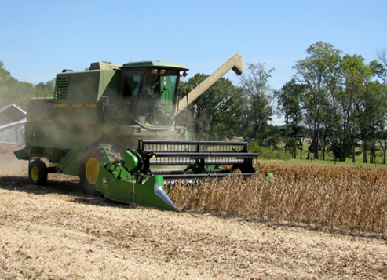
Soybean Weed Control Simplified
Start clean
Narrow rows (< 30”)
PRE
  Metribuzin + Group 15 or Prowl
    tolerant variety
  Irrigation or rainfall
POST + Residual (weeds <3” tall)
  Post = Reflex or Prefix or Warrant Ultra or Liberty or Zalo or Enlist One (2,4-D choline) or Enlist Duo (glyphosate + 2,4-D choline)
  Residual = Anthem Flexx/Max or Dual or Warrant or Outlook or Zidua
    Check tank-mix sites first

Slide 3
Metribuzin Products
Manufacturer | Trade Name | Active Ingredients
FMC | Authority MTZ | sulfentrazone + metribuzin
Syngenta | Boundary | s-metolachlor + metribuzin
Corteva | Canopy Canopy Blend | chlorimuron (10.7%) + metribuzin (64.3%) chlorimuron (8.3%) + metribuzin (50%)
NuFarm | Cloak | chlorimuron (10.7%) + metribuzin (64.3%)
Valent | Fierce MTZ | flumioxazin + pyroxasulfone + metribuzin
Loveland | Intimidator | s-metolachlor + fomesafen + metribuzin
NuFarm | Panther MTZ | flumioxazin + metribuzin
NuFarm | Panther Pro | flumioxazin + imazethapyr + metribuzin
Valent | Mauler | metribuzin
Syngenta | Tendovo | metribuzin + s-metolachlor + chloransulam
UPL | TriCor | metribuzin
Corteva | Trivence | flumioxazin + chlorimuron + metribuzin

Slide 4




Conventional Soybeans
PPO resistant weeds = SOL (really!)
Metribuzin – PRE
Prowl or Group 15’s
Reflex, Cobra, Ultra Blazer, Prefix, Warrant Ultra
Classic or FirstRate (sicklepod + MG)
  STS® (1993) - single gene (non-GMO)
  Bolt™ (2015) - 2 genes (non-GMO)

Slide 5
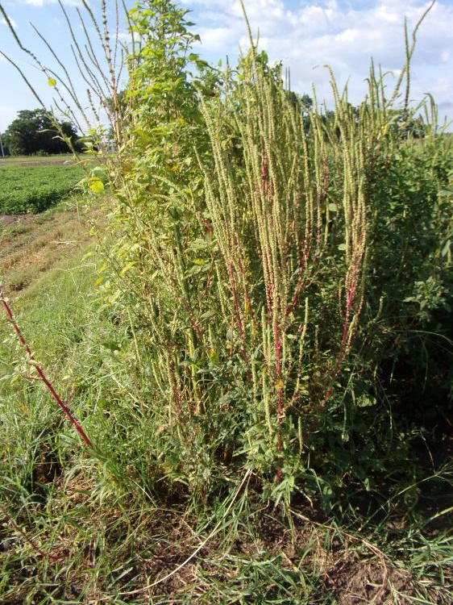
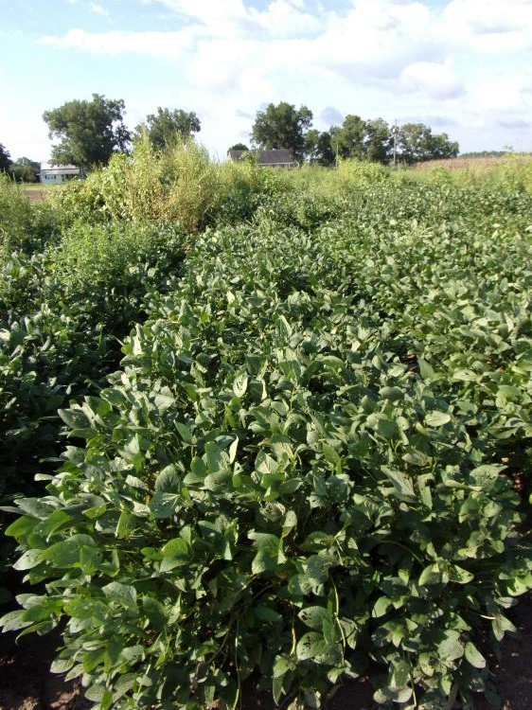
Soybean Weed Control – 2024
Conventional Systems (15” row spacing)
Tricor 4F @ 8 oz/A
Zidua 4.17SC @ 2.5 oz/A
PRE
Reflex 2SL @ 24 oz/A
Classic 25DG @ 0.5 oz/A
Induce @ 0.25% v/v
POST (31 DAP)
SB-04-24
August 19
104 DAP
NTC

Slide 6
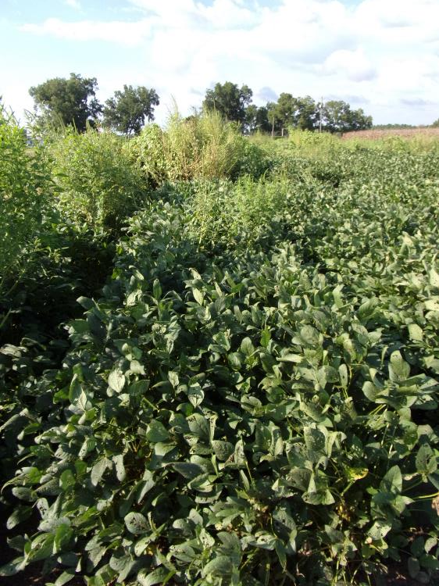
Soybean Weed Control – 2024
Conventional Systems (15” row spacing)
Tricor 4F @ 8 oz/A
Dual Magnum 7.62EC @ 16 oz/A
PRE
Reflex 2SL @ 24 oz/A
Classic 25DG @ 0.5 oz/A
Induce @ 0.25% v/v
POST (31 DAP)
SB-04-24
August 19
104 DAP
NTC

Slide 7
But would be OK with ……
PRE
  Valor or
  Envive (Valor + Classic + Harmony) or
  Surveil (Valor + FirstRate) or
  Fierce (Valor + Zidua) or
  Fierce MTZ (Valor + Tricor + Zidua) or
  Trivence (Valor + Tricor + Classic)
POST
  Roundup + Xtendimax/ Engenia + residual (Xtend System) or
  Liberty + residual (Liberty-Link or XtendFlex System) or
  Liberty + Enlist One + residual (Enlist System)

Slide 8
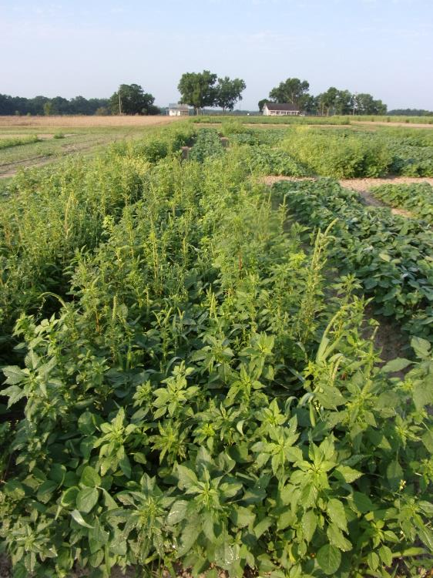
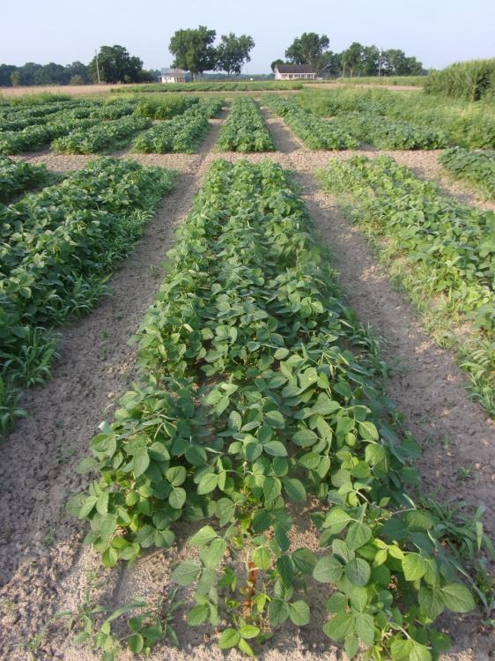


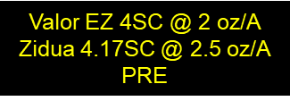
Soybean Weed Control - 2023
SB-05-23
June 6
48 DAT
NTC

Slide 9
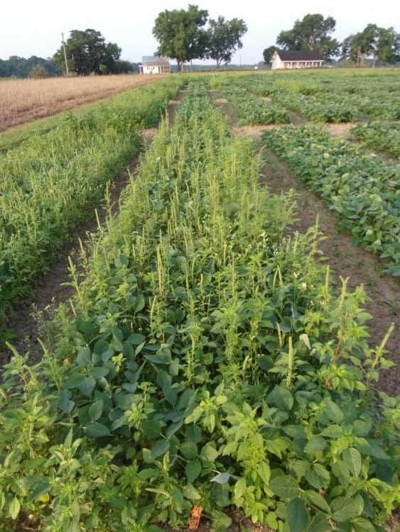

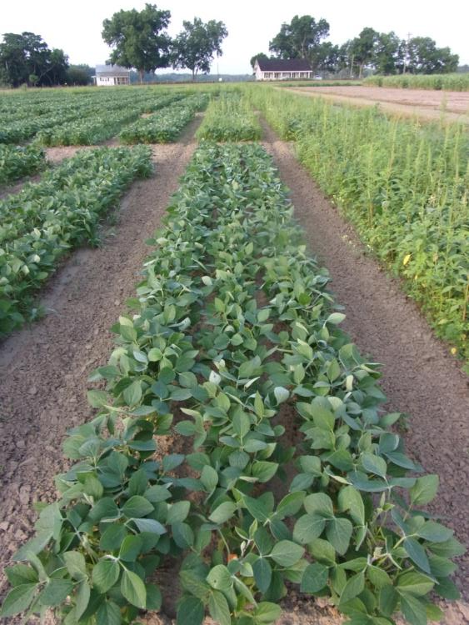
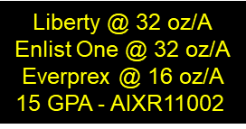
Enlist Soybeans - 2023
SB-04-23
June 6
29 DAT
NTC

Slide 10
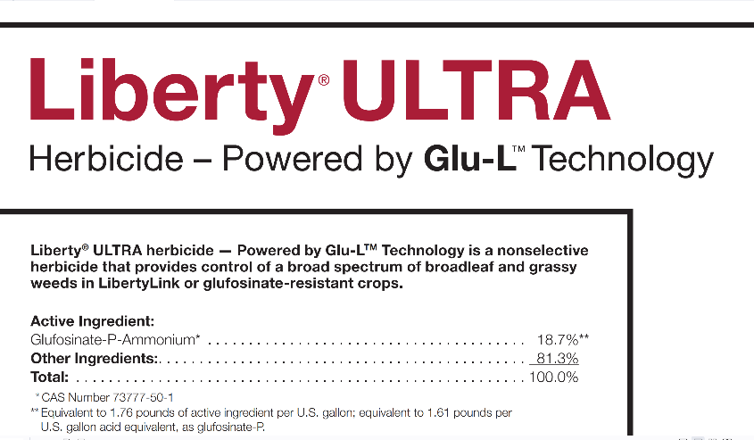
Liberty® ULTRA 1.76SL
BASF
glufosinate-P-ammonium
  More active isomer
  Dual vs. Dual Magnum
    Metolachlor vs. S-metolachlor
lower use rate (19-29 oz/A)
Mandatory downwind spray buffer
  ground = 10’/aerial = 50’
3 points for ESA runoff/erosion
  Tift Co. = 2 points
  sandy soils = 2 points

Slide 11
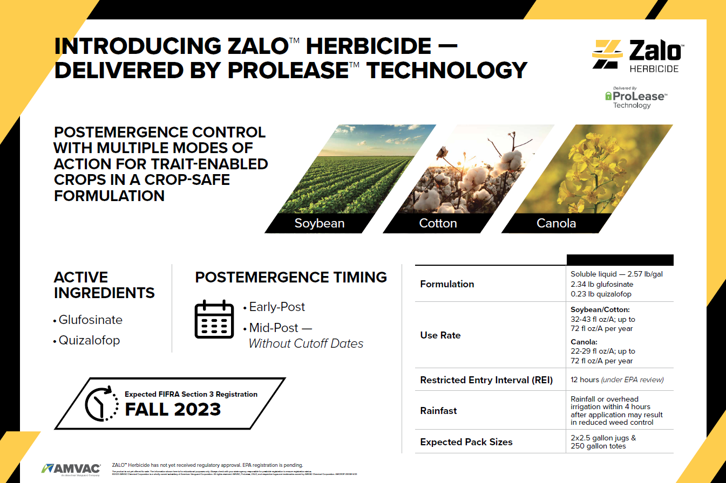

Slide 12

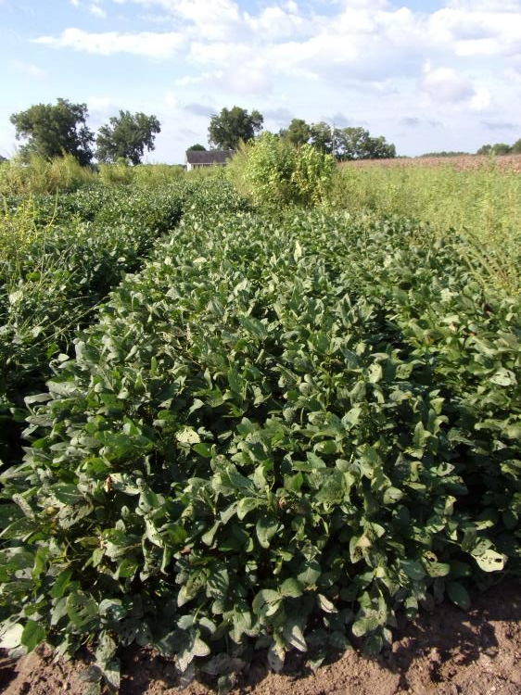
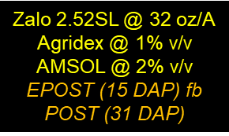
Soybean Weed Control – 2024
Liberty Systems (15” row spacing)
SB-04-24
August 19
104 DAP
NTC

Slide 13
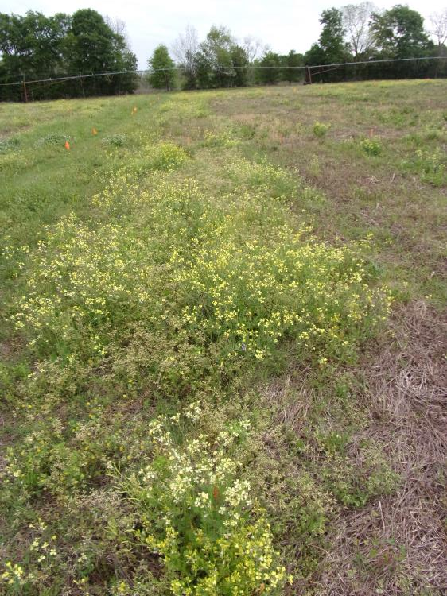
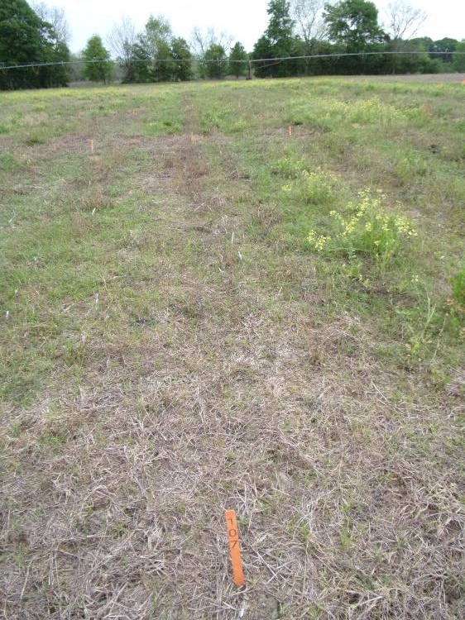
Pre-Plant Burndowns
Helmquat 3SL @ 32 oz/A
Rancor 4F @ 16 oz/A
AMSOL @ 2% v/v
MSO @ 1% v/v
BN-03-24
April 10
20 DAT
NTC

Slide 14

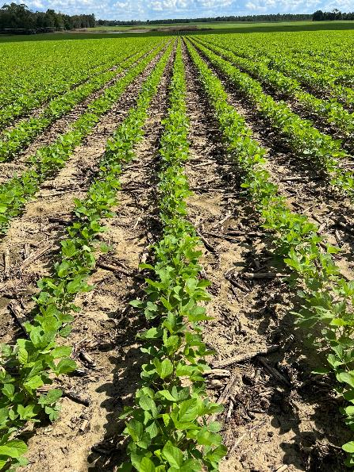
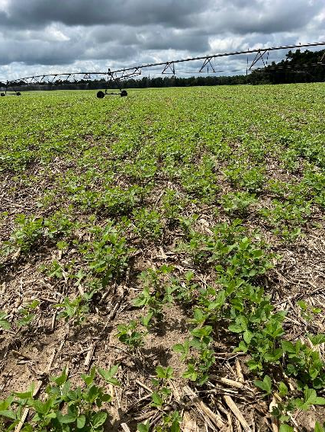
Double-Cropped Soybean
Behind Field Corn
What herbicides are safe?
  Roundup, Liberty, Group 15’s, Atrazine (?)
What about the HPPD herbicides?
  Callisto = 10 months
  Impact = 9 months
  Laudis = 8 months
  Shieldex = 9 months
What about south Georgia?
  Irrigation, sandier soils, low OM
    less carryover potential (?)

Slide 15



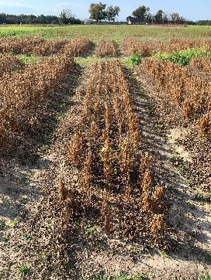
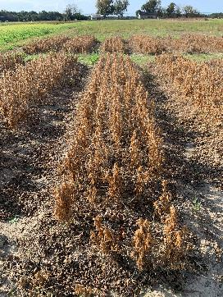

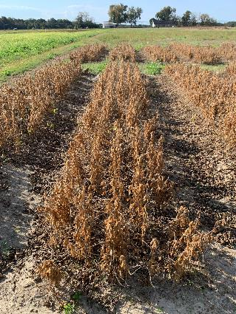


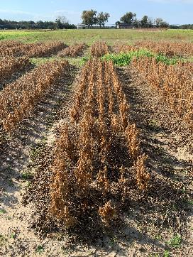
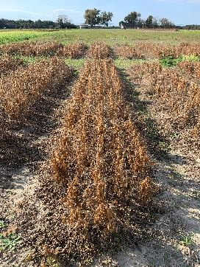
HPPD/Soybean Test - 2023
Planted 92 DAT
SB-03-23
October 31

Slide 16

Soybean Yield Response to HPPD Herbicides Applied 92 DBP* - 2023
LSD 0.10 = 9.8
-30%
Bu/A
-68%
SB-03-23
Asgrow AG66XF2
PD: July 3
7.5” rows

Slide 17

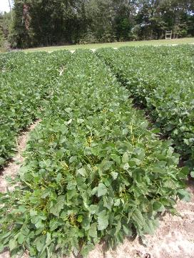
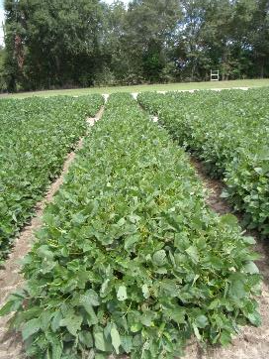
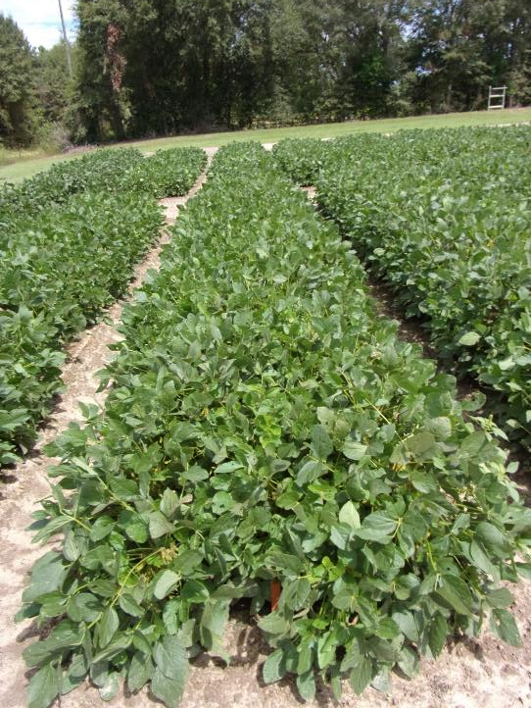
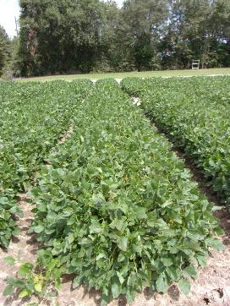
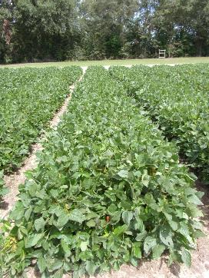
Soybean/HPPD – 2024
Planted July 8 (90 DAT)
Impact 2.8SC
1.25 oz/A
Laudis 3.5SC
3 oz/A
Shieldex 3.33SC
1.35 oz/A
SB-03-24
September 10
64 DAP
NTC

Slide 18
Soybean Yield Response to HPPD Herbicides Applied 90 DBP* - 2024
P = 0.7666
CV = 18.5
Bu/A
SB-03-24
Asgrow AG66XF2
PD: July 8
7.5” rows

Slide 19
Soybean/HPPD Tests (2023-2024)
Cumulative Rainfall From Application to Planting

Slide 20



Late Applications of PPO Herbicides
The diphenyl ether herbicides (Cobra, Reflex, Ultra Blazer) applied at reproductive growth stages (R1, R3, R5) have no negative impact on developing soybean flowers and pods. Even with foliar injury as high as 55%, soybean plants are able to compensate for this injury and produce yields comparable to nontreated soybean plants. Applications made by growers as “rescue” applications late in the season do not lead to soybean yield loss.
  Source: Beam et al. 2018. Weed Technology 32:444-447

Slide 21
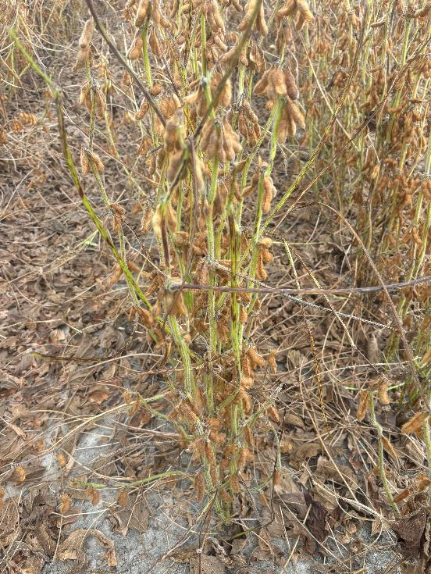
Green Stem Syndrome
SUCKS!
cultivar
stink bug/kudzu bug feeding
late herbicide application
fungicide application (“strobi”)
infection by one of several soybean viruses
late planting and/or emergence
mixed seed lots (seed lots of blended cultivars)
Paraquat not consistent
Asgrow 66XF2 Planted June 7
10 Days after Paraquat (Harvest Aid)
11/04/24

Slide 22
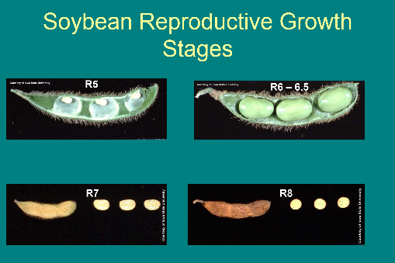
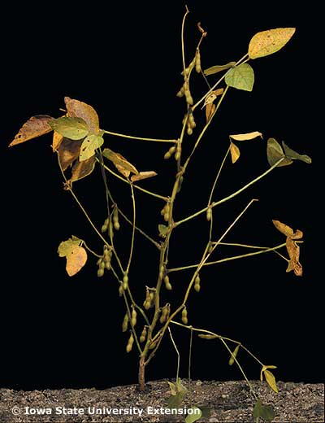
Soybean Harvest Aids
Roundup (glyphosate)
  7 d PHI
Gramoxone (paraquat)
  15 d PHI
Aim (carfentrazone)
  3 d PHI
Sharpen (saflufenacil)
  3 d PHI
Defol (sodium chlorate)
  10 d PHI
Source: LSU, Dr. Jim Griffin et al.
R7 = beginning maturity, 1 pod on mainstem has reached mature pod color

Slide 23
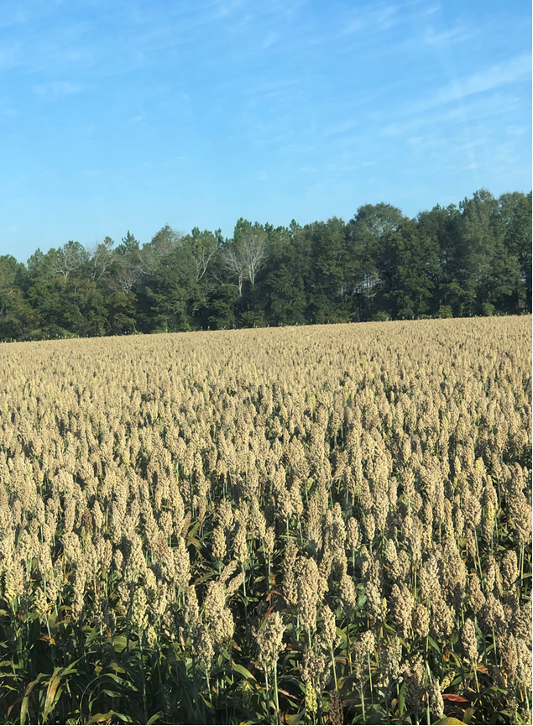

Weed Control in Grain Sorghum – 2025
Eric P. Prostko, Extension Weed Specialist
Seth McAllister, Terrell Co. (October 2022)

Slide 24
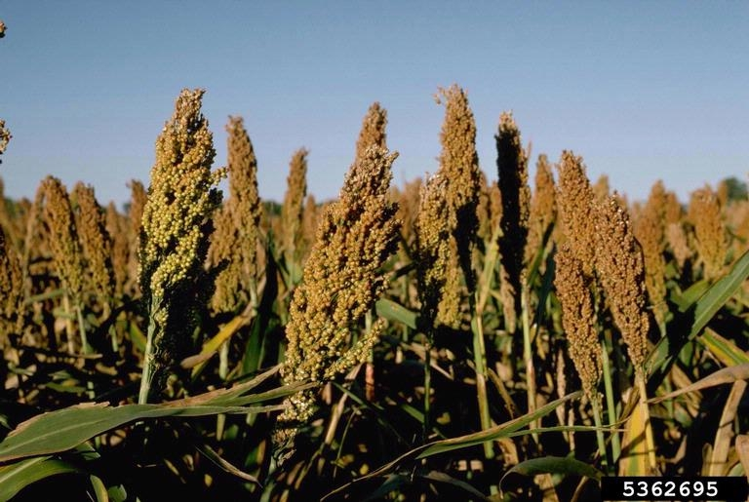
Grain Sorghum Weed Control
Start clean!
Concep treated seed
Dual Magnum or Outlook or Warrant (PRE)
Atrazine 4L @ 1.5 QT/A (EPOST)
  Add Huskie if you have ATZ resistance
Paraquat (Hooded sprayer)
Mechanical Cultivation

Slide 25

A New (er) Product to Consider?
Huskie 2.06EC
Bayer CropScience
Buctril (1.75 lbs/gal) + pyrasulfotole (0.31 lbs/gal)
MOA = 6 + 27
Postemergence (13-16 oz/A)
3-leaf to 12” tall sorghum
Broadleaf weeds, good on pigweed
Tank-mix with atrazine (16 oz/A)
  Huskie FX = Huskie + Starane

Slide 26
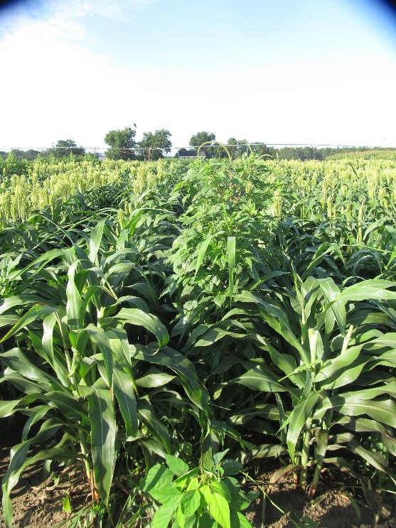
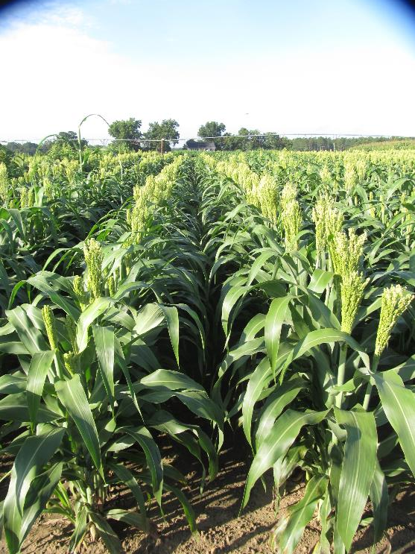

Grain Sorghum Weed Control - 2021
Warrant @ 48 oz/A
Atrazine @ 16 oz/A
Huskie @ 16 oz/A
Induce @ 0.25% v/v
AMS @ 5% v/v
Applied 19 DAP
NTC
GS-04-21
July 16
58 DAP

Slide 27
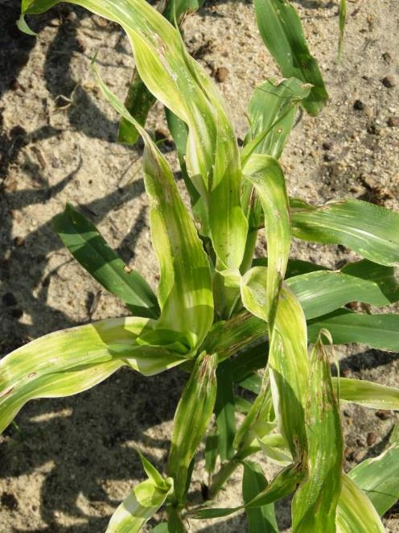
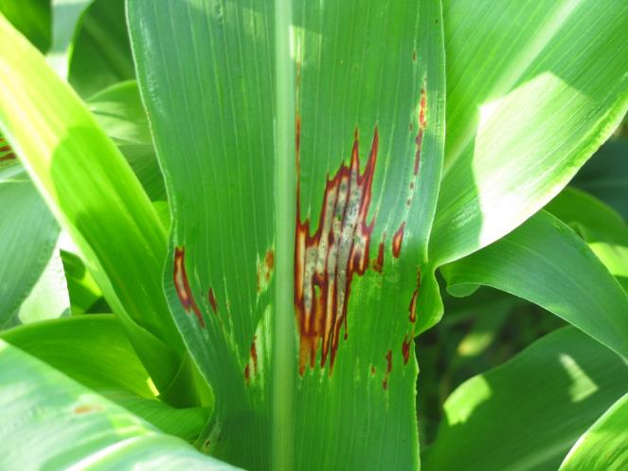

Huskie Injury on Sorghum

Slide 28
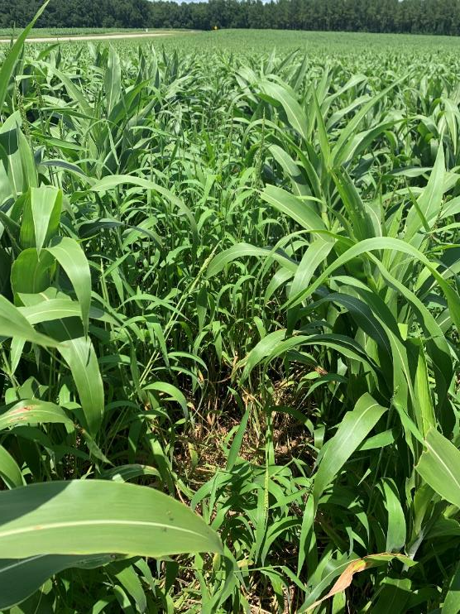
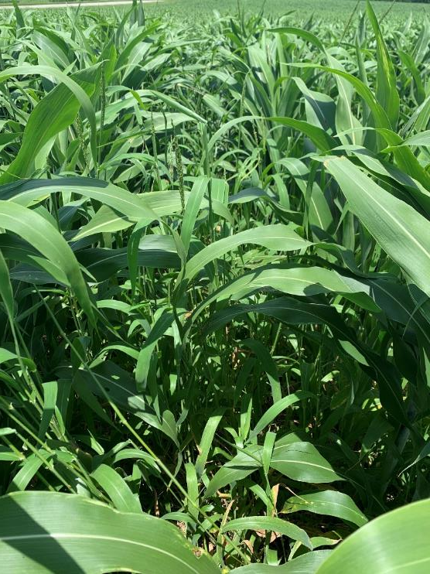
Texas Panicum in Grain Sorghum
Terrell Co.
08/05/22

Slide 29
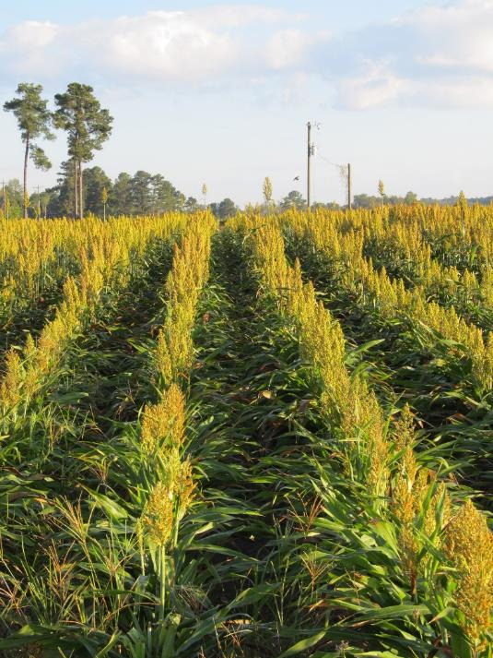
New Grain Sorghum Weed Control Technologies (Non-GMO)
Igrowth®
  Alta/UPL
  ImiFlex (imazamox)
    PRE/POST
DoubleTeam™
  S&W/Sorghum Partners/ADAMA
  FirstAct (quizalofop)
    POST
Inzen™
  Pioneer/Corteva
  Zest (nicosulfuron)
    POST

Slide 30


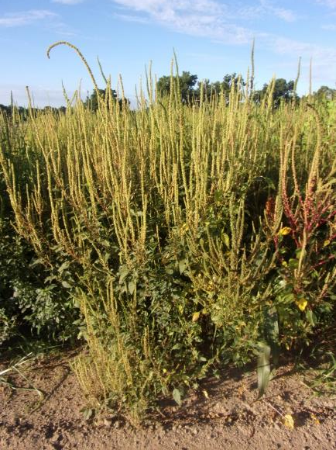
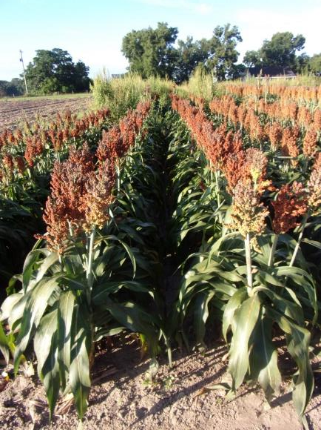
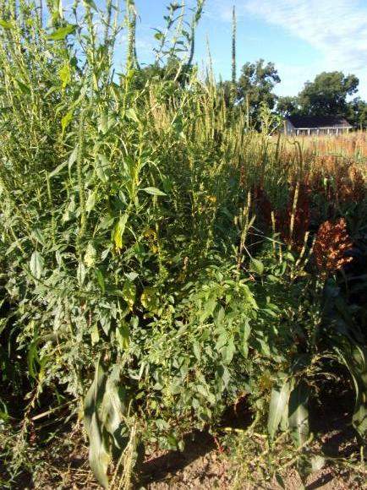
Grain Sorghum Weed Control – 2022
I-Growth
NTC
Mocassin II Plus 7.64EC @ 21 oz/A (PRE)
fb
Imiflex 1AS @ 6 oz/A
Agridex @ 1% v/v
POST (V7, 9-10” tall, 22 DAP)
Imiflex 1AS @ 4 oz/A
Agridex @ 1% v/v
EPOST (V3, 4” tall, 14 DAP)
GS-01-22
August 1
69 DAT (POST)/77 DAT (EPOST)

Slide 31
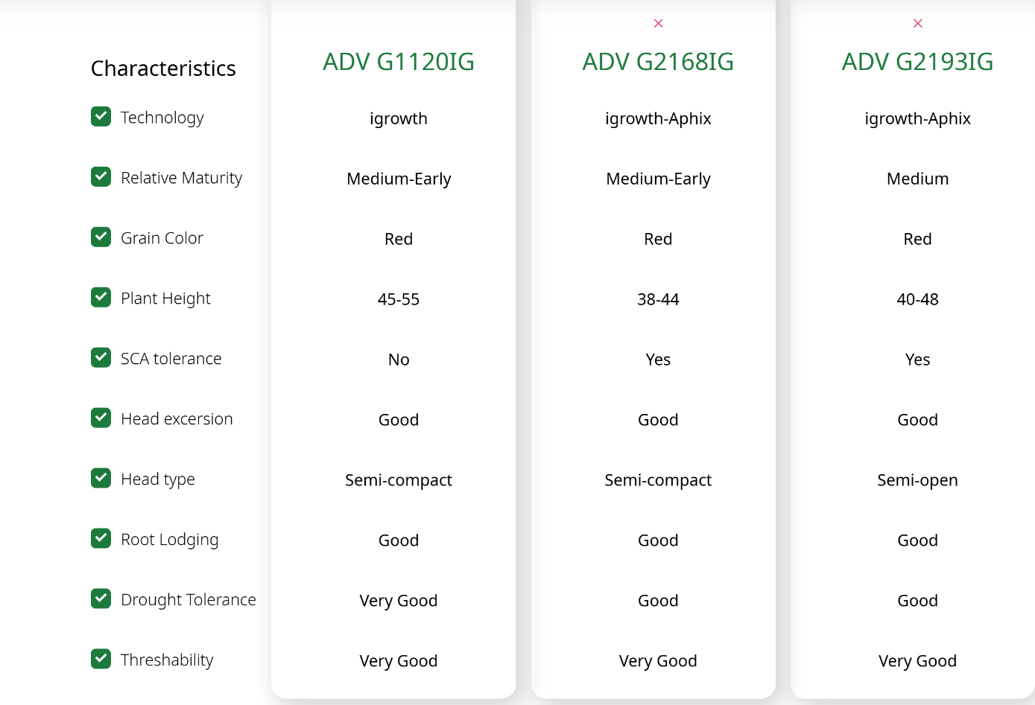

Igrowth Grain Sorghum Hybrids

Slide 32

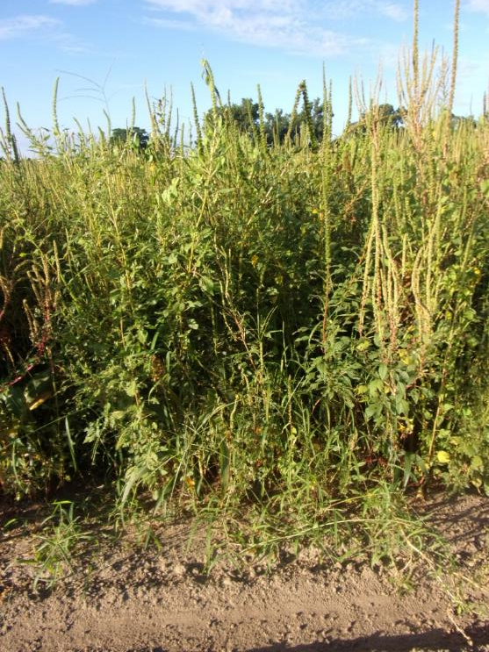
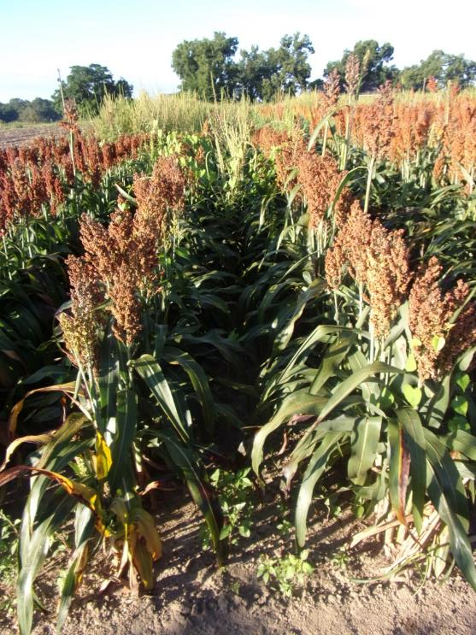
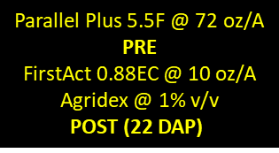
DoubleTeam Sorghum - 2022
NTC
GS-01-22
August 1
69 DAT (POST)

Slide 33
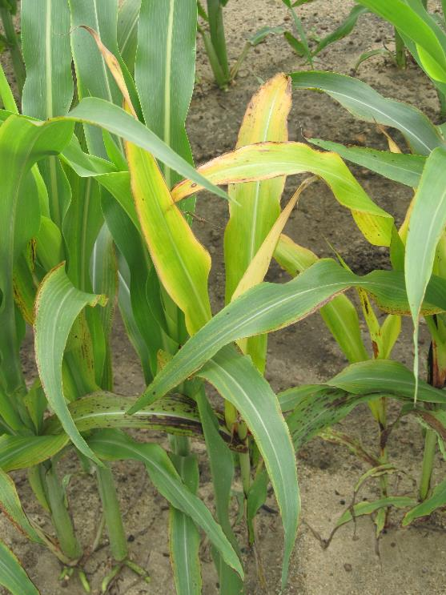
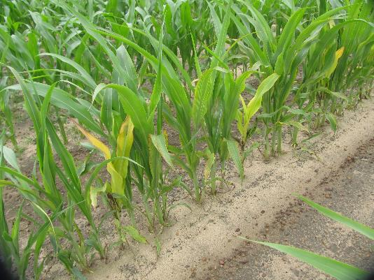
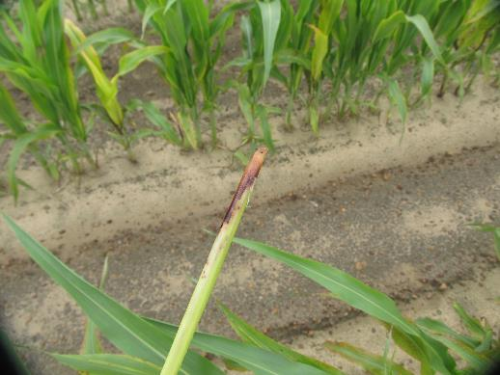
DoubleTeam™ System – First Act
Off-Types
GS-02-21
June 23
9 DAT

Slide 34


DoubleTeam Sorghum Hybrids
Numeric
1 = excellent
5 = average
9 = poor
SCA
1 = high tolerance
5 = moderate tolerance
9 = susceptible

Slide 35



Inzen Grain Sorghum - 2022
NTC
Everprex 7.62EC @ 16 oz/A (PRE) fb
Zest 75DG @ 0.67 oz/A +
Aatrex 4L @ 48 oz/A + Agridex @ 1% v/v
(POST)
GS-01-22
August 1
69 DAT (POST)

Slide 36
Sunflower Weed Control
Eric P. Prostko
Extension Weed Specialist
Dept. Crop & Soil Sciences
UGA - Tifton

Slide 37
What is labeled? (not much)
PPI
  Sonalan or Treflan
PPI or PRE
  Prowl, Dual Magnum, Zidua (only PRE), Spartan ($220/gal;3-4 oz/A; $5.16-6.88/A)
POST
  Arrow, Assure II, Select, Poast, SelectMax (grasses only)
  Beyond (imazamox)
    only on Clearfield hybrids
    Beyond same family as Cadre, Pursuit, and Scepter
    Beyond costs about $350/gal (4 ozs/A = $10.94)
    $205/bag (200,000 seed ~ 10 acres) = $20.50/A
    Clearfield sunflower hybrids are not GMO’s
Hooded Sprayer
  Aim 2EC @ 1-2 oz/A + COC @ 1% v/v
  Pigweeds must be 4” or less

Slide 38

Harvest Aids for Sunflowers
Paraquat
  2SL (19-32 oz/A
  3SL (13-21 oz/A)
Sodium Chlorate
  Defol 5
    4.8 qt/A
Sharpen (saflufenacil)
  1-2 oz/A
    MSO + AMS

Slide 39


Valor PRE on Sunflowers??
NO, NO, NO!
NTC
Valor EZ 4SC @ 3 oz/A
SN-01-24
June 5
28 DAP

Slide 40



Sunflower Weed Control - 2024
NTC
Spartan 4F @ 3.75 oz/A
Zidua 4.17SC @ 2.5 oz/A
PRE
Cadre 2AS 4 oz/A
Zidua 4.17SC @ 2.5 oz/A
Induce @ 0.25% v/v
POST (28 DAP)
Spartan 4F @ 3.75 oz/A
Zidua 4.17SC @ 2.5 oz/A
PRE
Beyond 1AS @ 4 oz/A
Zidua 4.17SC @ 2.5 oz/A
Induce 0.25% v/v
POST (28 DAP)
SN-01-24
July 1
54 DAP

Slide 41


Sunflower Weed Control - 2024
Surtain
(pyrox + saf)
Drift
NTC
Spartan 4F @ 3.75 oz/A
Dual Magnum 7.62EC @ 16 oz/A
PRE
Cadre 2AS 4 oz/A
Dual Magnum 7.62EC @ 16 oz/A
POST (28 DAP)
Spartan 4F @ 3.75 oz/A
Dual Magnum 7.62EC @ 16 oz/A
PRE
Beyond 1AS @ 4 oz/A
Dual Magnum 7.62EC @ 16 oz/A
POST (28 DAP)
SN-01-24
July 1
54 DAP

Slide 42







Know Who to Contact
(Your Extension Weed Science Team)
Eric Prostko
Peanuts, soybeans, field corn, sunflowers, grain sorghum, sesame, canola, field pea, sugarcane
Mark Czarnota
Ornamentals, small fruits, nursery,
landscape, greenhouse, Christmas Trees
Lisa Baxter
Pastures/Forages
Bob Stougaard
Pastures/Forages
Stanley Culpepper
Cotton, small grains,
vegetable crops (including sweet corn)
Wayne Mitchem
Tree fruits
(NCSU)
New Hire
Turf
Interviews completed

Slide 43


Slide 44


Forestry/Pine Trees
Warnell School of Forestry
David Dickens
Statesboro
David Clabo
Tifton

Slide 45

Questions/Comments?

